Slide 1

Overview
Chris Piech
CS106A, Stanford University

Slide 2
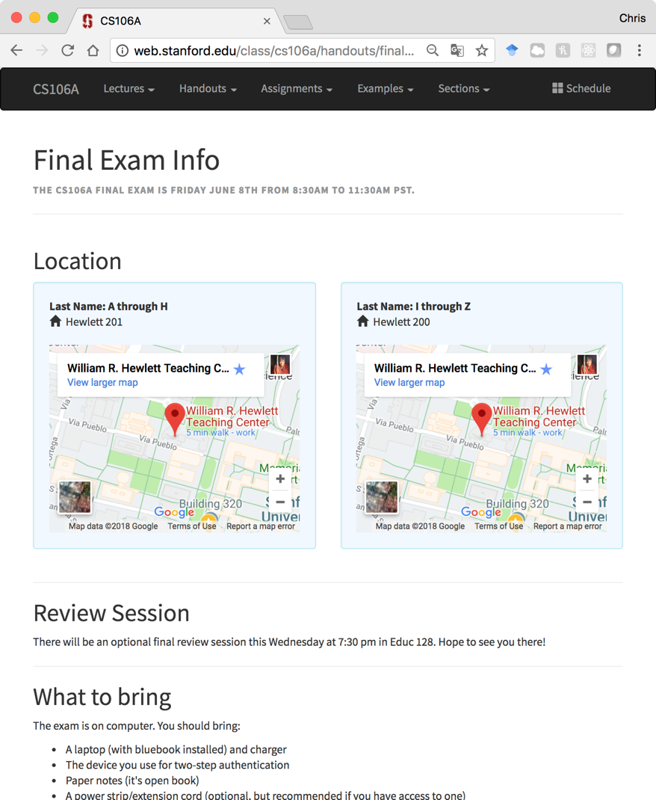
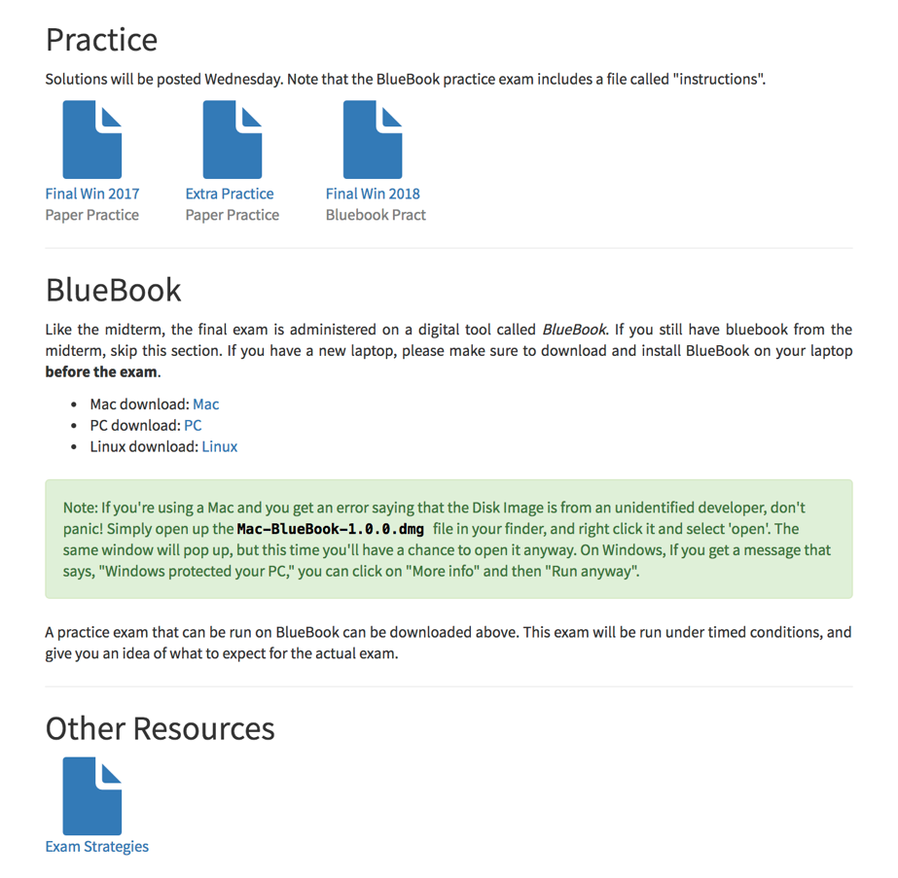
And if you scroll down….

Slide 3
Plan for today
Announcements/Exam logistics
Overview
Tracing
1D Arrays
2D Arrays
ArrayList
Montage

Slide 4
 | String | Array | 2D Array | ArrayList | HashMap
Model | Sequence of letters or symbols | Fixed length elements in a list | Grid / Matrix of elements | Growable list of elements | Key/Value mapping
Type of element | chars | Objects & Primitives | Objects & Primitives | Objects | Object/Object
Access Elements | str.charAt(i); | arr[i]; | arr[r][c]; | list.get(i); list.set(i, elem) list.add(elem) | map.put(key, value) map.get(key);
Special notes | Immutable | Watch bounds! | Row, col structure | Just fantastic | Each key must be unique. Unordered
Examples | ”Hello world” | Histogram | ImageShop pixels | Hangman words, entries in namesurfer | NSDatabase, FPDatabase

Slide 5
 | String | Array | 2D Array | ArrayList | HashMap
Model | Sequence of letters or symbols | Fixed length elements in a list | Grid / Matrix of elements | Growable list of elements | Key/Value mapping
Type of element | chars | Objects & Primitives | Objects & Primitives | Objects | Object/Object
Access Elements | str.charAt(i); | arr[i]; | arr[r][c]; | list.get(i); list.set(i, elem) list.add(elem) | map.put(key, value) map.get(key);
Special notes | Immutable | Watch bounds! | Row, col structure | Just fantastic | Each key must be unique. Unordered
Examples | ”Hello world” | Histogram | ImageShop pixels | Hangman words, entries in namesurfer | NSDatabase, FPDatabase

Slide 6
 | String | Array | 2D Array | ArrayList | HashMap
Model | Sequence of letters or symbols | Fixed length elements in a list | Grid / Matrix of elements | Growable list of elements | Key/Value mapping
Type of element | chars | Objects & Primitives | Objects & Primitives | Objects | Object/Object
Access Elements | str.charAt(i); | arr[i]; | arr[r][c]; | list.get(i); list.set(i, elem) list.add(elem) | map.put(key, value) map.get(key);
Special notes | Immutable | Watch bounds! | Row, col structure | Just fantastic | Each key must be unique. Unordered
Examples | ”Hello world” | Histogram | ImageShop pixels | Hangman words, entries in namesurfer | NSDatabase, FPDatabase

Slide 7
 | String | Array | 2D Array | ArrayList | HashMap
Model | Sequence of letters or symbols | Fixed length elements in a list | Grid / Matrix of elements | Growable list of elements | Key/Value mapping
Type of element | chars | Objects & Primitives | Objects & Primitives | Objects | Object/Object
Access Elements | str.charAt(i); | arr[i]; | arr[r][c]; | list.get(i); list.set(i, elem) list.add(elem) | map.put(key, value) map.get(key);
Special notes | Immutable | Watch bounds! | Row, col structure | Just fantastic | Each key must be unique. Unordered
Examples | ”Hello world” | Histogram | ImageShop pixels | Hangman words, entries in namesurfer | NSDatabase, FPDatabase

Slide 8
 | String | Array | 2D Array | ArrayList | HashMap
Model | Sequence of letters or symbols | Fixed length elements in a list | Grid / Matrix of elements | Growable list of elements | Key/Value mapping
Type of element | chars | Objects & Primitives | Objects & Primitives | Objects | Object/Object
Access Elements | str.charAt(i); | arr[i]; | arr[r][c]; | list.get(i); list.set(i, elem) list.add(elem) | map.put(key, value) map.get(key);
Special notes | Immutable | Watch bounds! | Row, col structure | Just fantastic | Each key must be unique. Unordered
Examples | ”Hello world” | Histogram | ImageShop pixels | Hangman words, entries in namesurfer | NSDatabase, FPDatabase

Slide 9
 | String | Array | 2D Array | ArrayList | HashMap
Model | Sequence of letters or symbols | Fixed length elements in a list | Grid / Matrix of elements | Growable list of elements | Key/Value mapping
Type of element | chars | Objects & Primitives | Objects & Primitives | Objects | Object/Object
Access Elements | str.charAt(i); | arr[i]; | arr[r][c]; | list.get(i); list.set(i, elem) list.add(elem) | map.put(key, value) map.get(key);
Special notes | Immutable | Watch bounds! | Row, col structure | Just fantastic | Each key must be unique. Unordered
Examples | ”Hello world” | Histogram | ImageShop pixels | Hangman words, entries in namesurfer | NSDatabase, SteamTunnel

Slide 10
Strings under the hood are 1D Array of chars
String str = “cs106a”;
‘c’ | ‘s’ | ‘1’ | ‘0’ | ‘6’ | ‘a’
0
1
2
3
4
5

Slide 11
2D Arrays = Array of Arrays
int[][] a = new int[3][4];
a[0][0] | a[0][1] | a[0][2] | a[0][3]
a[1][0] | a[1][1] | a[1][2] | a[1][3]
Outer array
a[2][0] | a[2][1] | a[2][2] | a[2][3]

Slide 12


Primitives, Objects, and Heap/Stack
Tracing

Slide 13
Primitives and Objects
Primitives: int, double, boolean, char,…
Objects: GRect, GOval, GLine, int[], … (anything with new, and that you call methods on)

Slide 14
Parameters
When passing parameters, make a copy of whatever is on the stack.
Primitives: the actual value is on the stack (pass by value)
Objects: a memory address where the information lives is on the stack. (pass by reference)
Notes:
Arrays are objects! (as are arrays within arrays)

Slide 15
Parameters: Primitives
public void run() { int x = 2;
addTwo(x);
println(x); // x is still 2!
}
private void addTwo(int y) {
y += 2;
}

Slide 16
Parameters: Objects
public void run() { GRect rect = new Grect(0,0,50,50);
fillBlue(rect);
add(rect); // rect is blue!
}
private void fillBlue(GRect rect) {
rect.setFilled(true);
rect.setColor(Color.BLUE);
}

Slide 17
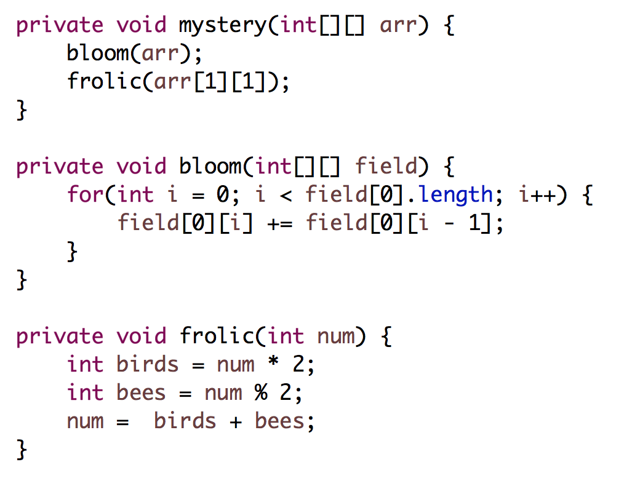
0 | 1 | 2
3 | 4 | 5
Input to mystery()
What is arr after?
Take 1
Notes:
[0, 1, 3]
[3, 4, 5]
8 never returned!

Slide 18
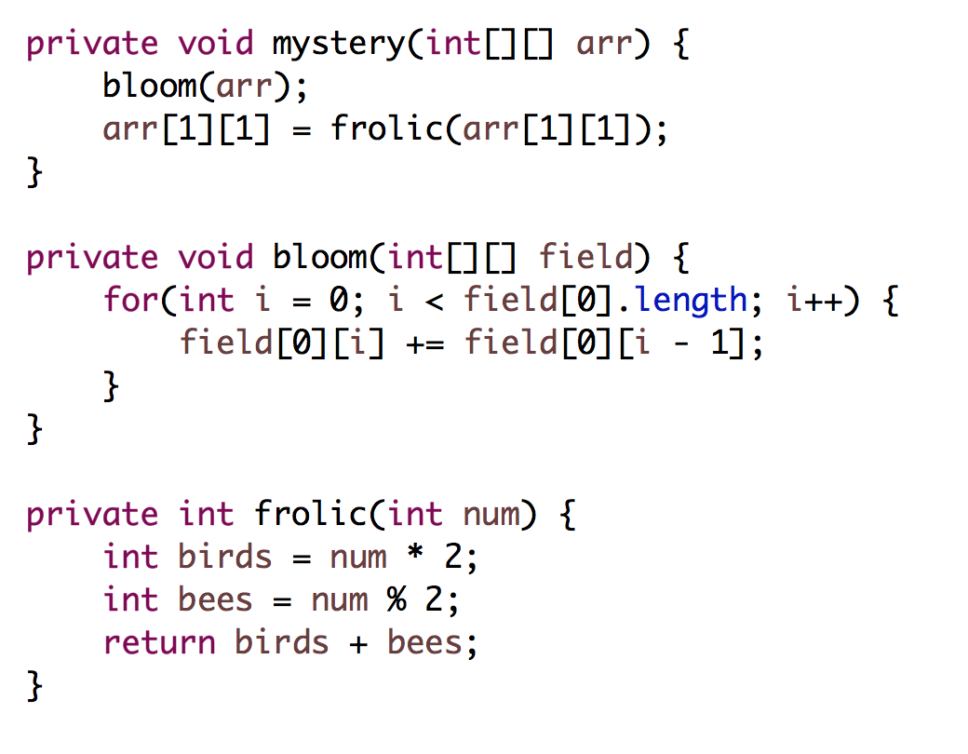
0 | 1 | 2
3 | 4 | 5
Input to mystery()
What is arr after?
Take 2
Notes:
[0, 1, 3]
[3, 8, 5]

Slide 19
Primitives, Objects, and Heap/Stack
2D Arrays

Slide 20
Get Max
// return the maximum value in the matrix
private double getMax(double[][] matrix) {

Slide 21
Get Max
// return the maximum value in the matrix
private double getMax(double[][] matrix) {
double maxValue = matrix[0][0];
for(int r = 0; r < matrix.length; r++) {
for(int c = 0; c < matrix[0].length; c++) {
if(matrix[r][c] > maxValue) {
maxValue = matrix[r][c];
}
}
}
return maxValue;
}

Slide 22
Get Max
// return the maximum value in the matrix
private double getMax(double[][] matrix) {
double maxValue = matrix[0][0];
for(int r = 0; r < matrix.length; r++) {
for(int c = 0; c < matrix[0].length; c++) {
if(matrix[r][c] > maxValue) {
maxValue = matrix[r][c];
}
}
}
return maxValue;
}

Slide 23
Get Max
// return the maximum value in the matrix
private double getMax(double[][] matrix) {
double maxValue = matrix[0][0];
for(int r = 0; r < matrix.length; r++) {
for(int c = 0; c < matrix[0].length; c++) {
if(matrix[r][c] > maxValue) {
maxValue = matrix[r][c];
}
}
}
return maxValue;
}

Slide 24
Make ASCII Art
private String[] makeAscii(GImage img) {
Original
Helper method
ASCII Art
double[][] brightness =
img.getPixelBrightness();
For each pixel chose one character to add to the corresponding row String.
If brightness greater than 0.66, use ’ ‘.
If the brightness is greater than 0.33, use ‘1’.
Else, you should use the character '0'.

Slide 25
private String[] makeAscii(GImage img) {
double[][] brightness = img.getPixelBrightness();
String[] lines = new String[brightness.length];
for(int r = 0; r < lines.length; r++) {
String line = "";
for(int c = 0; c < brightness[0].length; c++) {
double v = brightness[r][c];
if(v > 0.66) {
line += ' ‘;
} else if (v > 0.66) {
line += '1’;
} else {
line += '0’;
}
}
lines[r] = line;
}
return lines;
}

Slide 26
private String[] makeAscii(GImage img) {
double[][] brightness = img.getPixelBrightness();
String[] lines = new String[brightness.length];
for(int r = 0; r < lines.length; r++) {
String line = "";
for(int c = 0; c < brightness[0].length; c++) {
double v = brightness[r][c];
if(v > 0.66) {
line += ' ‘;
} else if (v > 0.66) {
line += '1’;
} else {
line += '0’;
}
}
lines[r] = line;
}
return lines;
}

Slide 27
private String[] makeAscii(GImage img) {
double[][] brightness = img.getPixelBrightness();
String[] lines = new String[brightness.length];
for(int r = 0; r < lines.length; r++) {
String line = "";
for(int c = 0; c < brightness[0].length; c++) {
double v = brightness[r][c];
if(v > 0.66) {
line += ' ‘;
} else if (v > 0.66) {
line += '1’;
} else {
line += '0’;
}
}
lines[r] = line;
}
return lines;
}

Slide 28
private String[] makeAscii(GImage img) {
double[][] brightness = img.getPixelBrightness();
String[] lines = new String[brightness.length];
for(int r = 0; r < lines.length; r++) {
String line = "";
for(int c = 0; c < brightness[0].length; c++) {
double v = brightness[r][c];
if(v > 0.66) {
line += ' ‘;
} else if (v > 0.66) {
line += '1’;
} else {
line += '0’;
}
}
lines[r] = line;
}
return lines;
}

Slide 29
private String[] makeAscii(GImage img) {
double[][] brightness = img.getPixelBrightness();
String[] lines = new String[brightness.length];
for(int r = 0; r < lines.length; r++) {
String line = "";
for(int c = 0; c < brightness[0].length; c++) {
double v = brightness[r][c];
if(v > 0.66) {
line += ' ‘;
} else if (v > 0.66) {
line += '1’;
} else {
line += '0’;
}
}
lines[r] = line;
}
return lines;
}

Slide 30
private String[] makeAscii(GImage img) {
double[][] brightness = img.getPixelBrightness();
String[] lines = new String[brightness.length];
for(int r = 0; r < lines.length; r++) {
String line = "";
for(int c = 0; c < brightness[0].length; c++) {
double v = brightness[r][c];
if(v > 0.66) {
line += ' ‘;
} else if (v > 0.66) {
line += '1’;
} else {
line += '0’;
}
}
lines[r] = line;
}
return lines;
}

Slide 31
Primitives, Objects, and Heap/Stack
Array List

Slide 32
ArrayList
An ArrayList is a flexible-length list of a single type of thing.
An ArrayList can only store objects.
For primitives use e.g. ArrayList<Integer> instead of ArrayList<int>. (Integer is a wrapper class for int)
Other wrapper classes: Double instead of double, Character instead of char, Boolean instead of boolean.
An ArrayList has a variety of methods you can use like .contains, .get, .add, .remove, .size, etc.

Slide 33
Array vs ArrayList
Array
Fixed size
Efficient (not a concern in this class)
No methods, can only use myArray.length (no parentheses!)
Can store any object or primitive
ArrayList
Expandable
Less efficient than Array (not a concern in this class)
Convenient methods like .add(), .remove(), .contains()
Cannot store primitives, so use their wrapper classes instead

Slide 34
deleteDuplicates()
private void deleteDuplicates(ArrayList<String> list)
Guaranteed that list is in sorted order
{"be", "be", "is", "not", "or”, "or”, "or", "question", "that", "the", "to"} becomes {“be”, “is”, “not”, “or”, “question”, “that”, “the”, “to”}
Solution strategy:
Loop through ArrayList
Compare pairs of elements
If element.equals(nextElement), remove element from the list

Slide 35
deleteDuplicates()
0
1
2
3
4
5
6
7
8
9
10
List
{"be", "be", "is", "not", "or”, "or”, "or", "question", "that", "the", "to"}
curr
next
Current Index (i):
0

Slide 36
deleteDuplicates()
0
1
2
3
4
5
6
7
8
9
10
List
{"be", "be", "is", "not", "or”, "or”, "or", "question", "that", "the", "to"}
curr
next
Current Index (i):
0

Slide 37
deleteDuplicates()
0
1
2
3
4
5
6
7
8
9
10
List
{"be", "be", "is", "not", "or”, "or”, "or", "question", "that", "the", "to"}
Current Index (i):
0

Slide 38
deleteDuplicates()
0
1
2
3
4
5
6
7
8
9
List
{"be", "is", "not", "or”, "or”, "or", "question", "that", "the", "to"}
Current Index (i):
0

Slide 39
deleteDuplicates()
0
1
2
3
4
5
6
7
8
9
List
{"be", "is", "not", "or”, "or”, "or", "question", "that", "the", "to"}
Current Index (i):
1

Slide 40
deleteDuplicates()
0
1
2
3
4
5
6
7
8
9
List
{"be", "is", "not", "or”, "or”, "or", "question", "that", "the", "to"}
curr
next
Current Index (i):
1

Slide 41
Sometime later…

Slide 42
deleteDuplicates()
0
1
2
3
4
5
6
7
8
9
List
{"be", "is", "not", "or”, "or”, "or", "question", "that", "the", "to"}
curr
next
Current Index (i):
3

Slide 43
deleteDuplicates()
0
1
2
3
4
5
6
7
8
9
List
{"be", "is", "not", "or”, "or”, "or", "question", "that", "the", "to"}
curr
next
Current Index (i):
3

Slide 44
deleteDuplicates()
0
1
2
3
4
5
6
7
8
9
List
{"be", "is", "not", "or”, "or”, "or", "question", "that", "the", "to"}
Current Index (i):
3

Slide 45
deleteDuplicates()
0
1
2
3
4
5
6
7
8
List
{"be", "is", "not", "or”, "or", "question", "that", "the", "to"}
Current Index (i):
3

Slide 46
deleteDuplicates()
4
8
0
1
2
3
4
5
6
7
List
{"be", "is", "not", "or”, "or", "question", "that", "the", "to"}
Current Index (i):
4

Slide 47
deleteDuplicates()
0
1
2
3
4
5
6
7
8
List
{"be", "is", "not", "or”, "or", "question", "that", "the", "to"}
curr
next
Current Index (i):
4

Slide 48
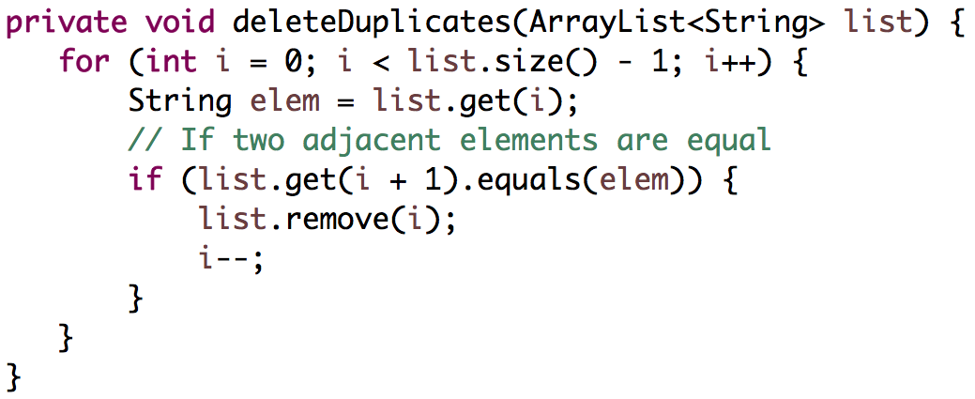
deleteDuplicates()
Loop through ArrayList
Compare pairs of elements
If element.equals(nextElement), remove element from the list
Strategy #1

Slide 49
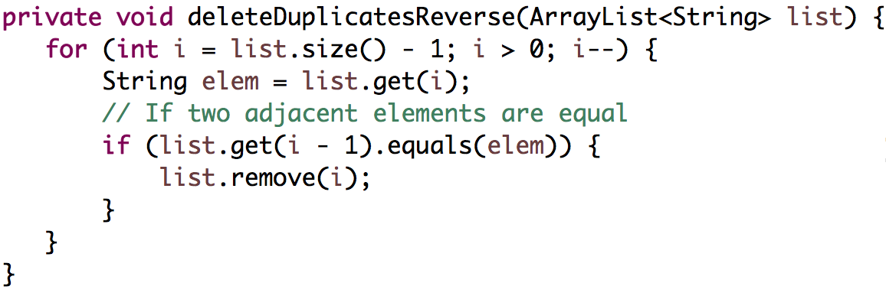
deleteDuplicates()
Loop through ArrayList in reverse
Compare pairs of elements
If element.equals(previousElement), remove element from the list
Strategy #2

Slide 50
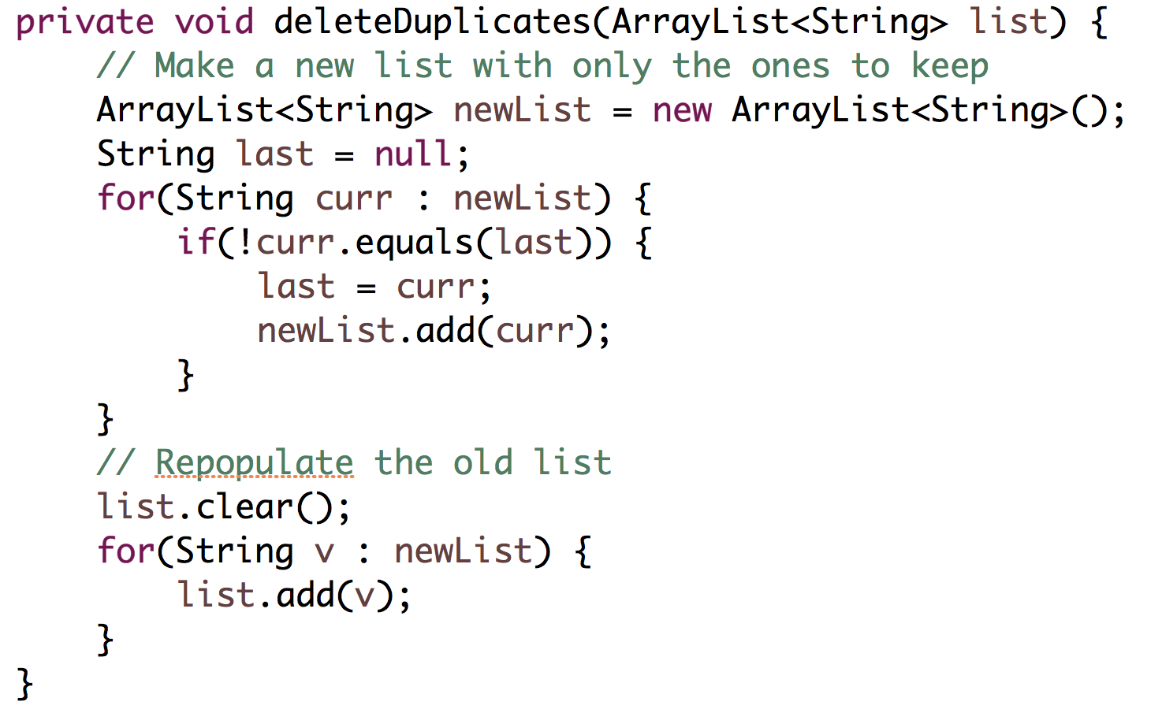
deleteDuplicates()
Strategy #3

Slide 51
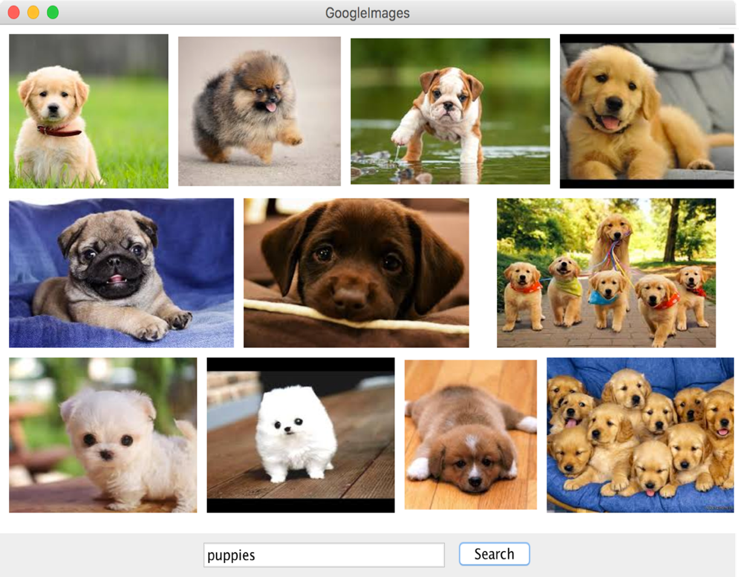
Google Images
public void displayQuery(String query) {
1
2
3
4
Use a helper method:
ArrayList<GImage> results =
getSearchResults(query);
5
6
7
display your images in three rows of fixed height ROW_HEIGHT . You can scale images, but should maintain the ratio of their width to height. You can change the size of a GImage using it’s
setSize(width, height) method
8
9
There is a spacing of GAP pixels between each picture. You can optionally include the GAP between the pictures and the border of the window.
No image should go off the screen. You should not display all 100 returned images – only display the ones that fit into the three rows.

Slide 52
You have come a long way

Slide 53
Good morning
Notes:
He looks like an old machintosh machine.
Hes got legs… one sticks out the back. That’s just the way it is.

Slide 54
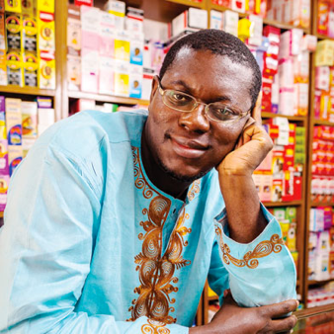

Slide 55
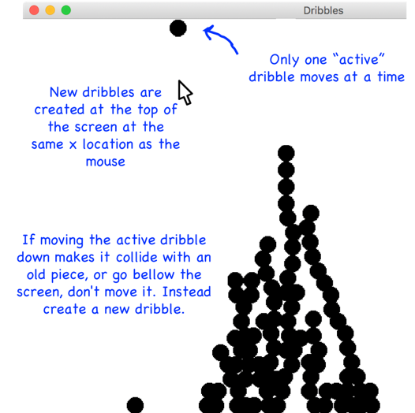

Slide 56
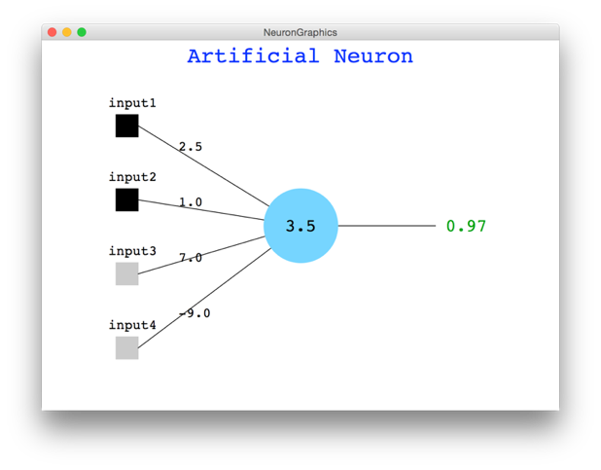

Slide 57
By the numbers

Slide 58
10 weeks

Slide 59
7 hard assignments

Slide 60
14,000 person hours programming

Slide 61
350 pieces of fruit

Slide 62
1 class ☺

Slide 63
You have my respect.

Slide 64
Why Study CS?

Slide 65
Joy of Building

Slide 66
Interdisciplinary

Slide 67

Closest Thing To Magic

Slide 68
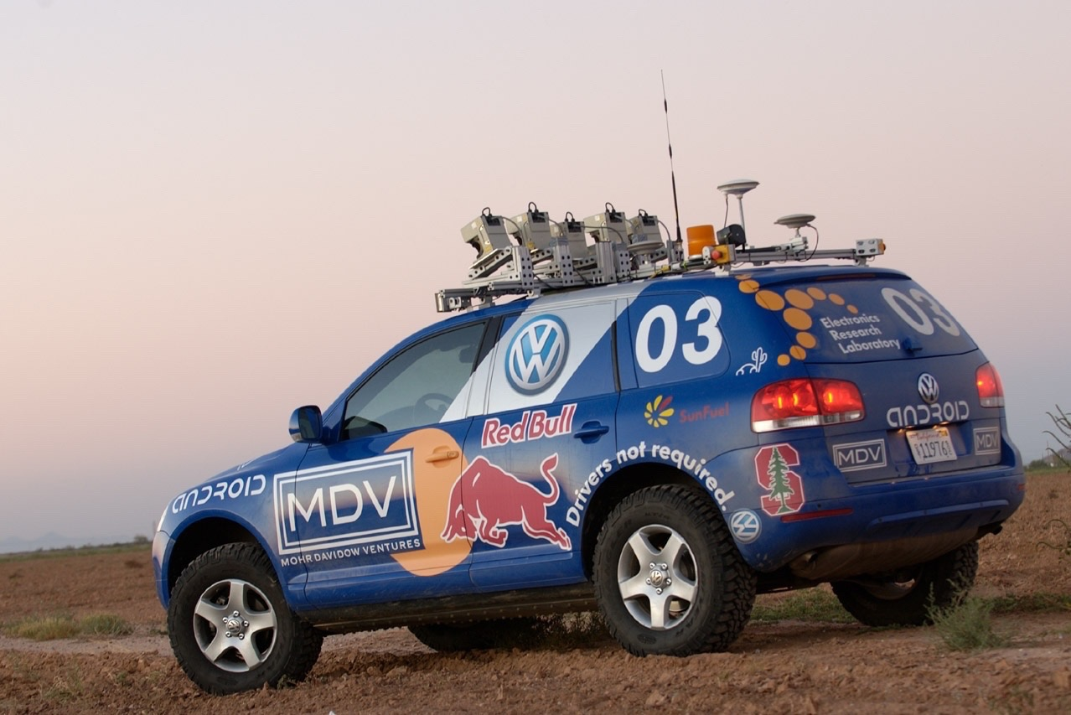
Now is the Time

Slide 69

Everyone is Welcome
Notes:
One of my favorite things about programming is that we are all equal infront of Eclispe.
Eclipse does not care your ethnicity, gender, orientation.
That theme is part of the essence of CS106A.
Last night Oprah talked about the new day that is on the horizon! CS too is having a new day and it is very exciting future for the phenomenal women and men sitting in this classroom.

Slide 70
The End

Slide 71
public void displayQuery(String query) {
ArrayList<GImage> results = getSearchResults(query);
int index = 0;
int row = 0;
int currX = GAP;
int currY = GAP;
while(row < 3) {
GImage img = results.get(index);
double ratio = img.getWidth() / img.getHeight();
double width = ROW_HEIGHT * ratio;
if(currX + width < getWidth()) {
add(img, currX, currY);
currX += width + GAP;
index++;
} else {
row++;
currX = GAP;
currY += ROW_HEIGHT + GAP;
}
}
}

